Slide 1
Image Classification using Machine learning A COURSE PROJECT by
Khushi Arora – RA1911003010198 Heena Rungta – RA1911003010207 Aryan Malhotra – RA1911003010242
Tushar Solanki - RA1911003010249

Slide 2
Abstract
The report provides the information about IMAGE CLASSIFICATION USING MACHINE LEARNING.
The description captures objects contained in an image and expresses how the objects relate to each other and the activities they are involved in.
The classification problem is to categorize all the pixels of a digital image into one of the defined classes.
The main aim of using image classification in our project is to classify a given image into one of the categories using Machine and Deep Learning and understand the difference in classification.

Slide 3
The task of image classification is to teach the computer to recognize images and classify them into one of the trained categories.
To do so, we first need to teach the computer how a cat, a dog, a bird, etc. look like before it being able to recognize a new object. The more cats the computer sees, the better it gets in recognizing cats. This is known as supervised learning.
The computer will start recognizing patterns present in cat pictures that are absent from other ones and will start building its own cognition. We make use of Python to write the program.

Slide 4
Objective
our project aims to make an image classification model using machine learning that can give us a highly accurate result.
The main motive behind doing this project was to make it more accurate than the older ones. Along with making it more simple and easy to use.
We have tried to make it user friendly for beginners.

Slide 5
Methodology
Techniques Used
DATA PRE – PROCESSING - In any Machine Learning process, Data Pre-processing is that step in which the data gets transformed, or Encoded to bring it to such a state that now the machine can easily parse it. Pre-processing is required to clean image data for model input. For example, fully connected layers in convolutional neural networks required that all images are the same sized arrays.

Slide 6
FEATURE EXTRACTION - The technique of extracting the features is useful when you have a large data set and need to reduce the number of resources without losing any important or relevant information. Feature extraction helps to reduce the amount of redundant data from the data set.
ML MODE - A machine learning model is a file that has been trained to recognize certain types of patterns. You train a model over a set of data, providing it an algorithm that it can use to reason over and learn from those data.

Slide 7
HOG - Histogram of Oriented Gradients, is a feature descriptor that is often used to extract features from image data. It is widely used in computer vision tasks for object detection. The technique counts occurrences of gradient orientation in localized portions of an image or region of interest.
PIPELINE MODEL - ML pipeline is a means of automating the machine learning workflow by enabling data to be transformed and correlated into a model that can then be analysed to achieve outputs. This type of ML pipeline makes the process of inputting data into the ML model fully automated.

Slide 8
MODELS USED
SCIKIT-IMAGE - Scikit-image is an open-source image processing library for the Python programming language.
NUMPY - NumPy arrays are the basis of all computations performed by the NumPy library. They are simple Python lists with a few additional properties.
PANDAS - Pandas (all lowercase) is a popular Python-based data analysis toolkit which can be imported using import pandas as pd.
DATASET - A data set (or dataset) is a collection of data.

Slide 9
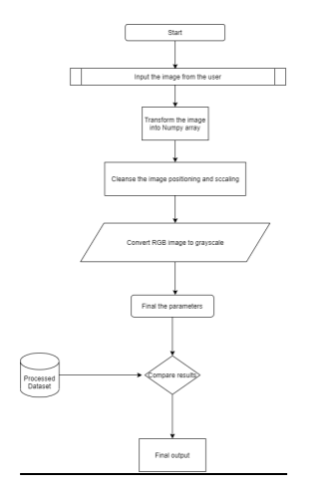
flowchart

Slide 10
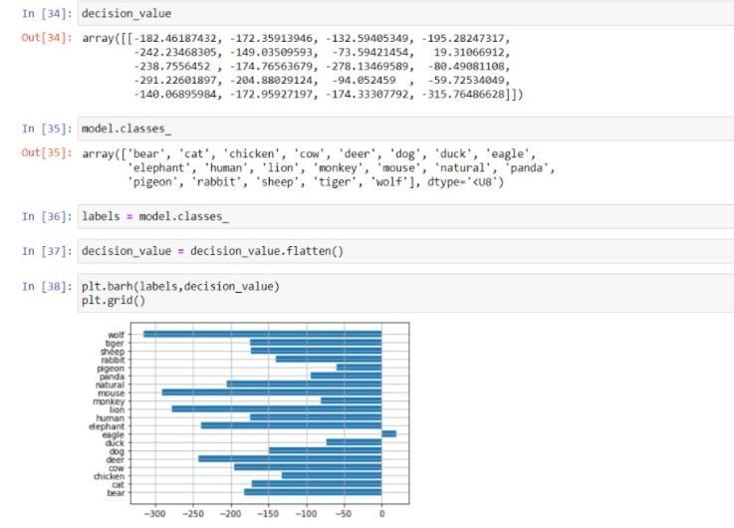
output

Slide 11
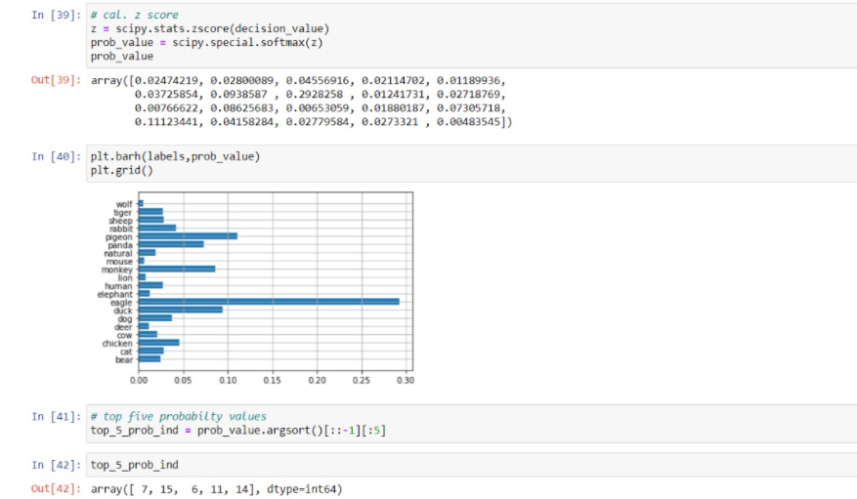

Slide 12
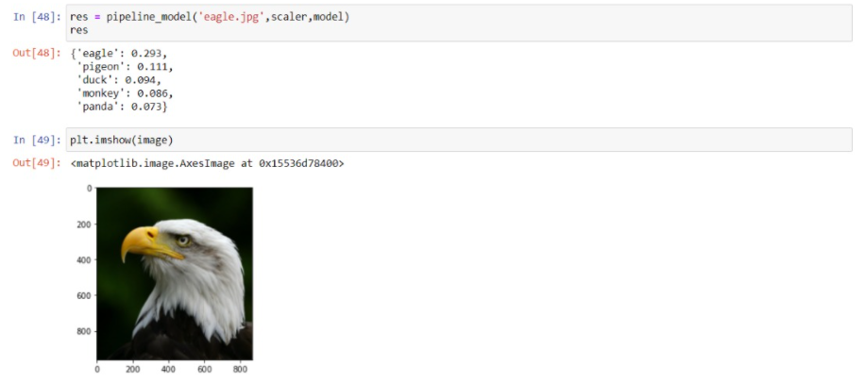

Slide 13
Result
The results obtained from the classification model yields an accuracy of about 99% which is better than some conventional techniques used in other classification methods. In future, the dataset can be improved by increasing its volume and adding more and more data to it.

Slide 14
CONCLUSION
Hence, we can conclude that our project, Image classification using Machine Learning was successfully done using Jupiter notebook in Python. It described the content of an image using properly formed English sentences. The description captured objects contained in an image and expressed how these objects relate to each other and the activities they were involved in.

Slide 15
Thank you!

